Slide 1
Planning 2
Some material adapted from slides by Tim Finin,Jean-Claude Latombe, Lise Getoor, and Marie desJardins

Slide 2
Today’s Class
Partial-order planning
Graph-based planning
Additional planning methods
Hierarchical Task Networks
Case-Based Planning
Contingent Planning
Replanning
Multi-Agent Planning

Slide 3
Partial-order planning
A linear planner builds a plan as a totally ordered sequence of plan steps
A non-linear planner (aka partial-order planner) builds up a plan as a set of steps with some temporal constraints
constraints of the form S1<S2 if step S1 must comes before S2.
One refines a partially ordered plan (POP) by either:
adding a new plan step, or
adding a new constraint to the steps already in the plan.
A POP can be linearized (converted to a totally ordered plan) by topological sorting

Slide 4
Least commitment
Non-linear planners embody the principle of least commitment
only choose actions, orderings, and variable bindings that are absolutely necessary, leaving other decisions till later
avoids early commitment to decisions that don’t really matter
A linear planner always chooses to add a plan step in a particular place in the sequence
A non-linear planner chooses to add a step and possibly some temporal constraints

Slide 5
The initial plan
Every plan starts the same way
S1:Start
Initial State
Goal State
S2:Finish

Slide 6
Trivial example
Operators:
Op(ACTION: RightShoe, PRECOND: RightSockOn, EFFECT: RightShoeOn)
Op(ACTION: RightSock, EFFECT: RightSockOn)
Op(ACTION: LeftShoe, PRECOND: LeftSockOn, EFFECT: LeftShoeOn)
Op(ACTION: LeftSock, EFFECT: leftSockOn)
S1:Start
Steps: {S1:[Op(Action:Start)],
S2:[Op(Action:Finish,
Pre: RightShoeOn^LeftShoeOn)]}
Links: {}
Orderings: {S1<S2}
RightShoeOn ^ LeftShoeOn
S2:Finish

Slide 7
Solution
Start
Left Sock
Right Sock
Left Shoe
Right Shoe
Finish

Slide 8
Partial-order planning algorithm
Create a START node with the initial state as its effects
Create a GOAL node with the goal as its preconditions
Create an ordering link from START to GOAL
While there are unsatisfied preconditions:
Choose a precondition to satisfy
Choose an existing action or insert a new action whose effect satisfies the precondition
(If no such action, backtrack!)
Insert a causal link from the chosen action’s effect to the precondition
Resolve any new threats
(If not possible, backtrack!)
Notes:
Start second lecture here!

Slide 9
Solving the Sussman anomaly
Using the principle of least commitment: The planner avoids making decisions until there is a good reason to make a choice.
A
C
B
A
B
C

Slide 10
Two types of links
Causal links (bold arrows) achieve necessary preconditions and must be protected.
Ordering constraints (light arrows) indicate partial order between actions.
Every new action is after *start* and before *end*.

Slide 11
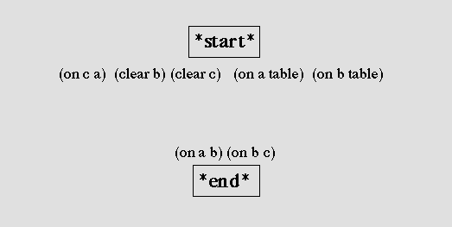
The null plan for the Sussman anomaly contains two actions: *start* specifies the initial state and *end* specifies the goal.

Slide 12
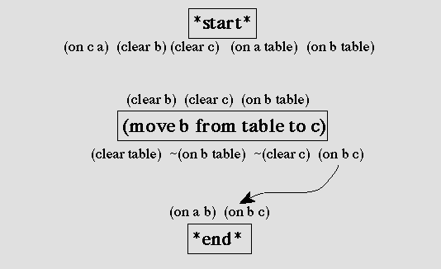
The plan after adding a causal link to support (on a b) Agenda contains [(clear b) (clear c) (on b table) (on a b)]

Slide 13
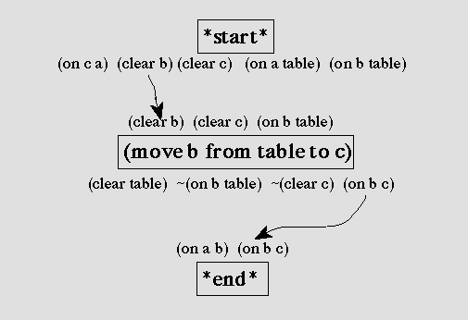
The plan after adding a causal link to support (clear b) The agenda is set to [(clear c) (on b table) (on a b)]

Slide 14
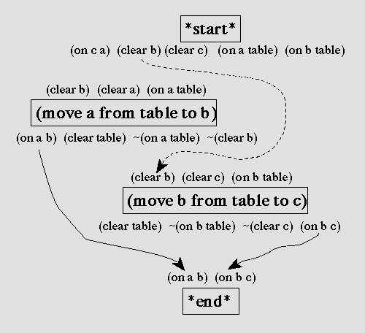
Because the move-a action could precede the move-b action, it threatens the link labled (clear b), shown by the dashed line.

Slide 15
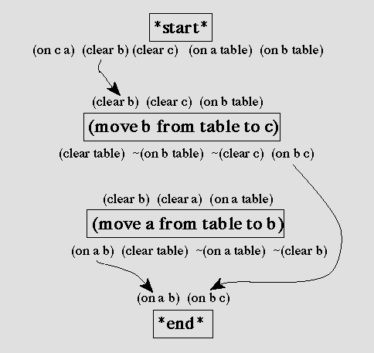
After promoting the threatening action, the plan’s actions are totally ordered.

Slide 16
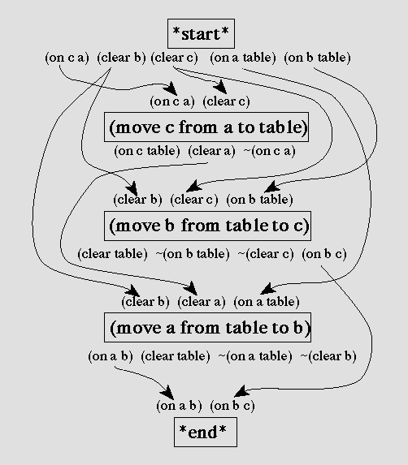

Slide 17
Example 2: The shopping problem
Initial state:
At(Home) ∧ Sells(HWS,Drill) ∧ Sells(SM,Milk) ∧ Sells(SM,Banana)
Goal state:
At(Home) ∧ Have(Milk) ∧ Have(Drill) ∧ Have(Banana)

Slide 18
Action representation
Op(Action: Start, Effect: At(Home) ∧ Sells(HWS,Drill) ∧ Sells(SM,Milk) ∧ Sells(SM,Banana))
Op(Action: Finish, Preconds: At(Home) ∧ Have(Milk) ∧ Have(Drill) ∧ Have(Banana))
Op(Action: Go(there), Preconds: At(here), Effect: At(there) ∧ ¬ At(here))
Op(Action: Buy(x), Preconds: At(store) ∧ Sells(store,x), Effect: Have(x))

Slide 19
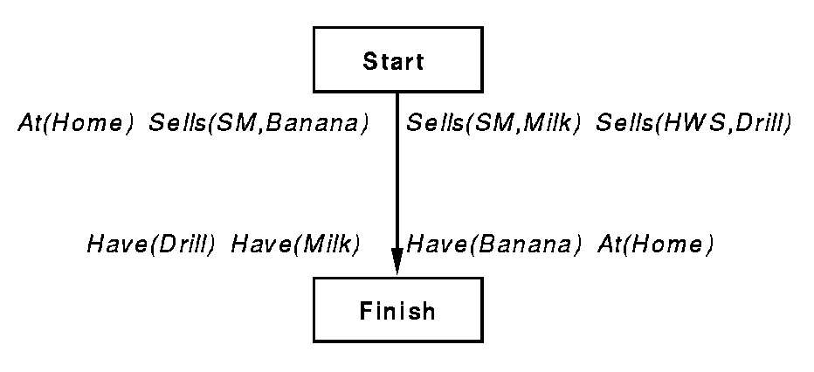
The initial plan

Slide 20
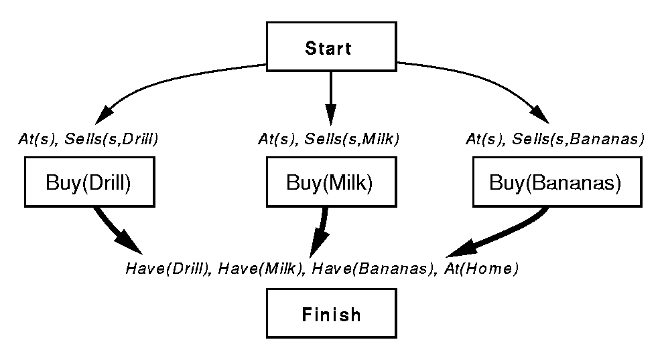
Partial plan achieves the “Have” preconditions

Slide 21
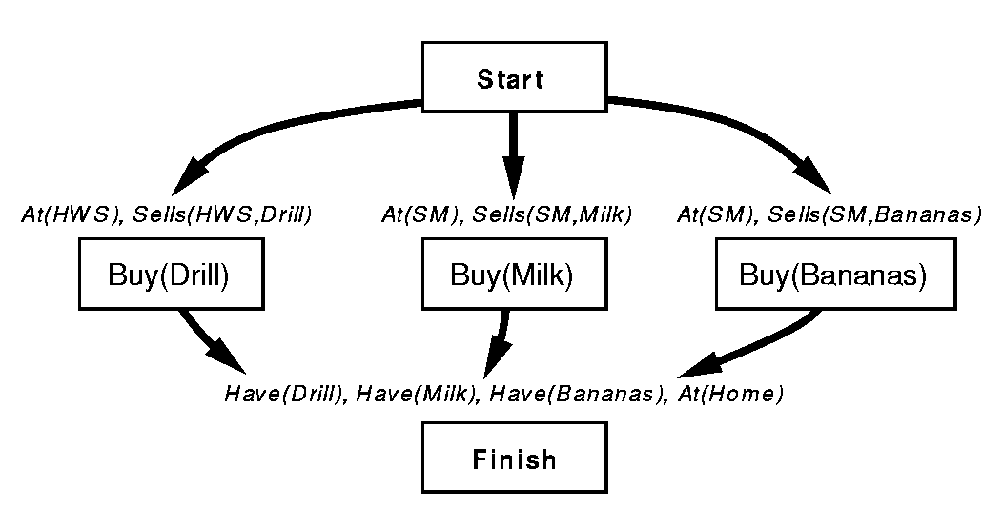
Causal links for the preconditions of “Sells”

Slide 22
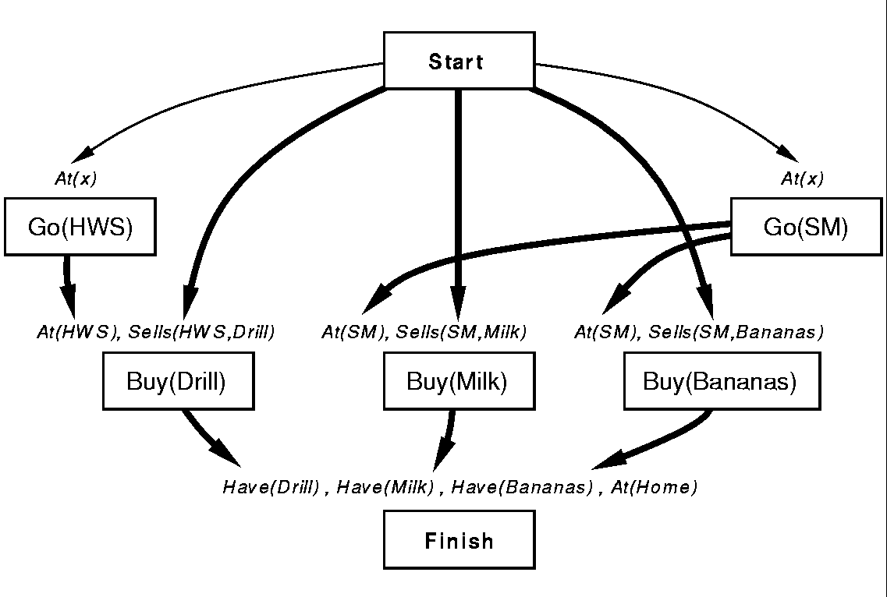
Achieving the “At” preconditions

Slide 23
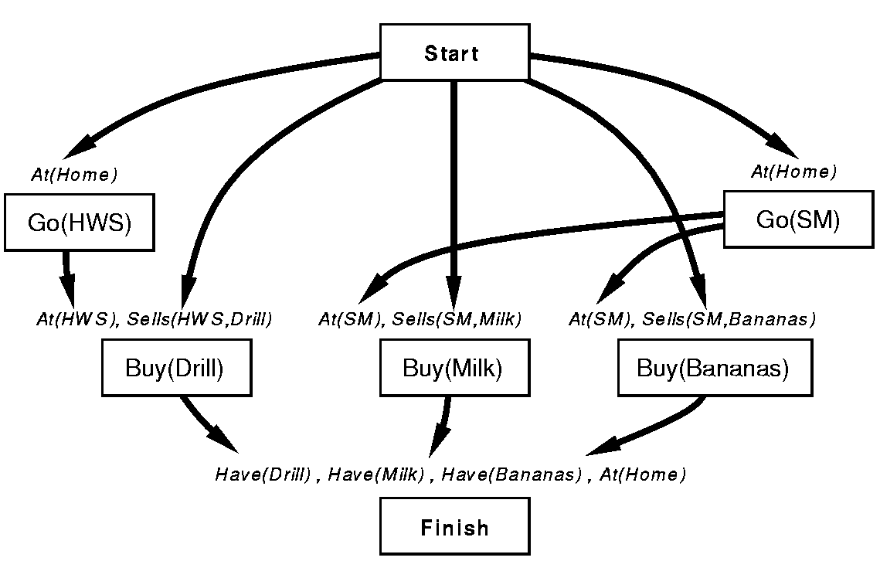
Go(HWS) threatens a protected link At(Home)

Slide 24
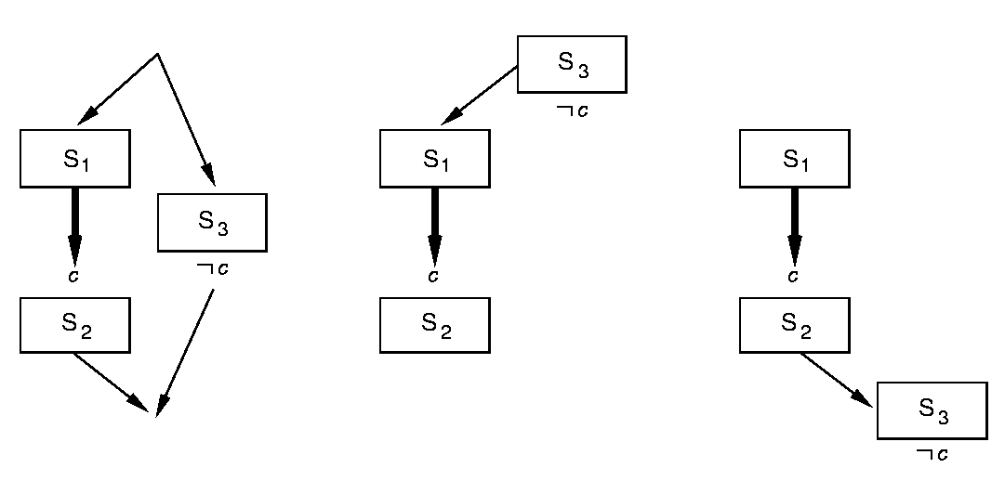
Protecting causal links
Promotion of S₃
Demotion of S₃

Slide 25
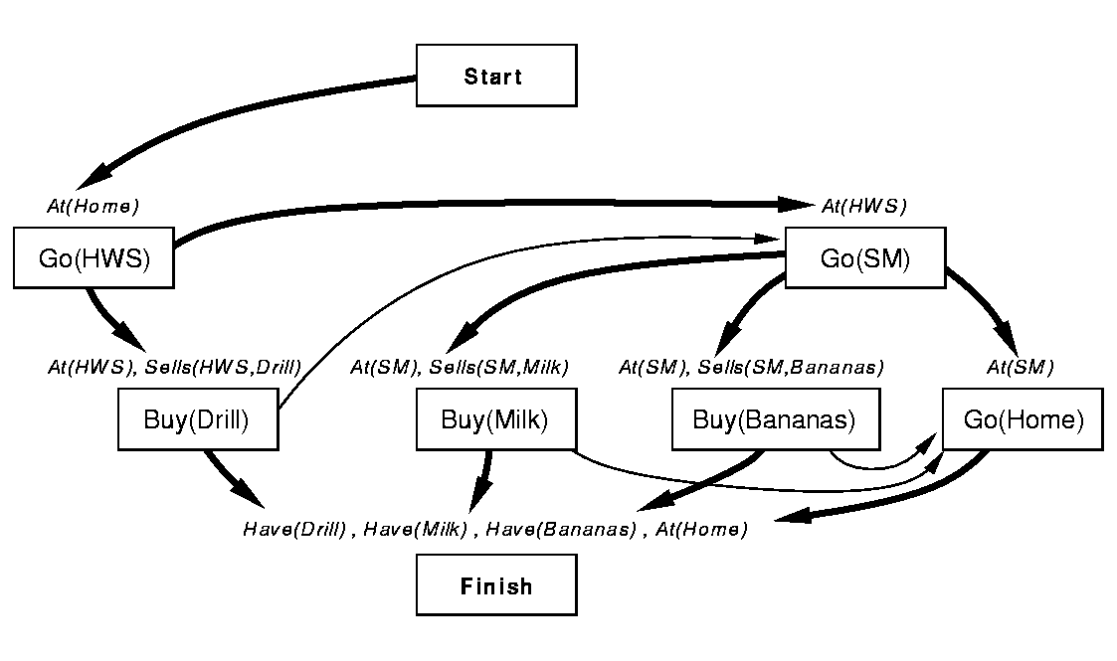
Causal link protection

Slide 26
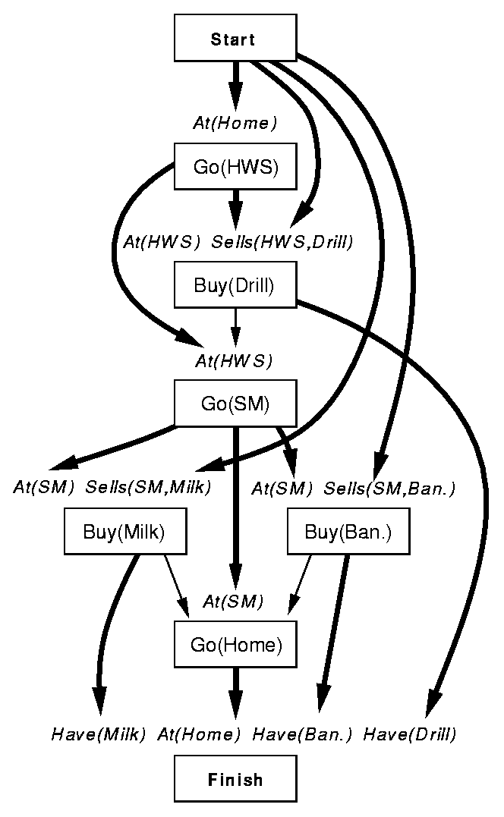

Slide 27
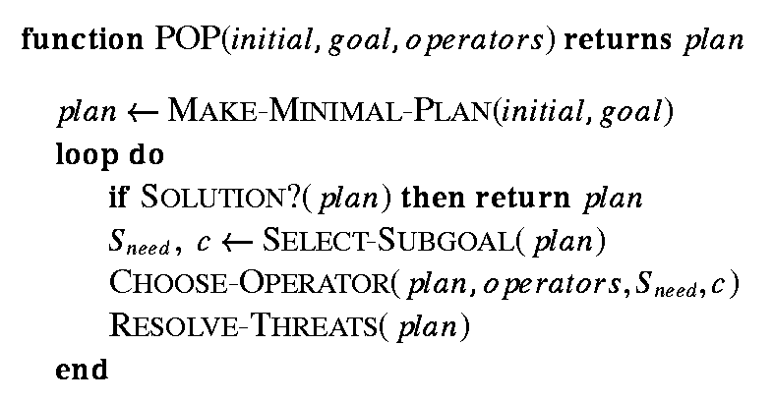
The partial-order planning algorithm

Slide 28
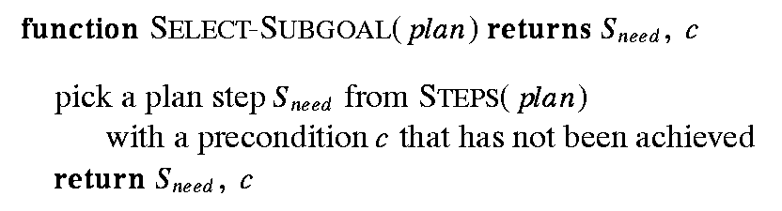
POP: SELECT-SUBGOAL

Slide 29
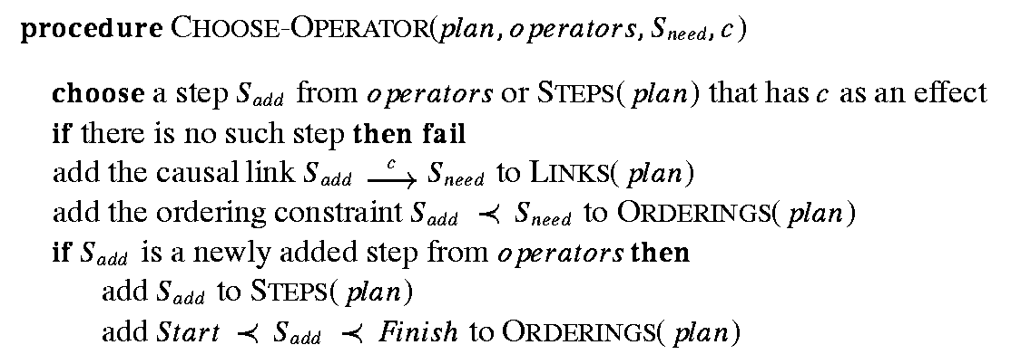
POP: CHOOSE-OPERATOR

Slide 30
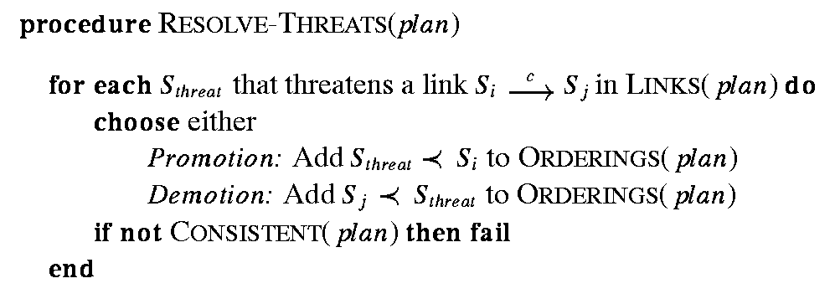
POP: RESOLVE-THREATS

Slide 31
POP is sound and complete
The partial-order planning algorithm is sound and complete, provided that the nondeterministic algorithm is implemented with a breadth-first or iterative deepening search strategy.

Slide 32
Advantages of partial-order planning
It takes only a few steps to construct a plan that would take thousands of steps using a standard problem solving approach.
The least commitment nature of the planner means it needs to search only in places where subplans interact with each other.
The causal links allow the planner to recognize when to abandon a doomed plan without wasting a lot of time.

Slide 33
A richer representation: Planning with generic operators
Operators can include variables
(make-op :action '(put ?block on table)
:preconds '((?block on ?something) (cleartop ?block))
:add-list '((?block on table) (cleartop ?something))
:del-list '((?block on ?something)))
(make-op :action '(put ?a on ?b)
:preconds '((cleartop ?a) (cleartop ?b) (?a on ?something))
:add-list '((?a on ?b) (cleartop ?something))
:del-list '((cleartop ?b) (?a on ?something)))

Slide 34
STRIPS-style planning with vars
An appropriate operator has an add-list element that unifies with the goal.
Operator preconditions are being unified with current state.
Operators have to be “instantiated” based on the above bindings.
Planning with partially instantiated operators.

Slide 35
Example:
State: '((C on A) (A on Table) (B on Table) (cleartop C) (cleartop B))
Goal: '(A on B)
Match 1: (A on B) with (?a on ?b)
op :action '(put A on B)
:preconds '((cleartop A) (cleartop B) (A on ?something))
:add-list '((A on B) (cleartop ?something))
:del-list '((cleartop B) (A on ?something)))
Match 2: (A on ?something) with (A on Table))
op :action '(put A on B)
:preconds '((cleartop A) (cleartop B) (A on Table))
:add-list '((A on B) (cleartop Table))
:del-list '((cleartop B) (A on Table)))

Slide 36
POP with generic operators
Add-list can be matched with goal as in STRIPS-style planning.
No explicit state representation ⇒ must handle partially instantiated operators.
Should an operator that causes ¬At(x) be considered a threat to the condition At(Home)?
How to deal with potential threats

Slide 37
Dealing with possible threats
Resolve with equality constraints: All possible threats are resolved immediately by giving the variable an acceptable value.
Resolve with inequality constraints: Allows the constraint (x ≠ Home), needs a more general unification algorithm.
Resolve later: Ignore possible threats until they become threats, and resolve then. Harder to determine if a plan is valid.

Slide 38
GraphPlan: Basic idea
Construct a graph that encodes constraints on possible plans
Use this “planning graph” to constrain search for a valid plan
Planning graph can be built for each problem in a relatively short time

Slide 39
Planning graph
Directed, leveled graph with alternating layers of nodes
Odd layers (“state levels”) represent candidate propositions that could possibly hold at step i
Even layers (“action levels”) represent candidate actions that could possibly be executed at step i, including maintenance actions [do nothing]
Arcs represent preconditions, adds and deletes
We can only execute one real action at any step, but the data structure keeps track of all actions and states that are possible

Slide 40
GraphPlan properties
STRIPS operators: conjunctive preconditions, no conditional or universal effects, no negations
Planning problem must be convertible to propositional representation
Can’t handle continuous variables, temporal constraints, …
Problem size grows exponentially
Finds “shortest” plans (by some definition)
Sound, complete, and will terminate with failure if there is no plan

Slide 41
What actions and what literals?
Add an action in level A_{i} if all of its preconditions are present in level S_{i}
Add a literal in level S_{i} if it is the effect of some action in level A_{i-1} (including no-ops)
Level S₀ has all of the literals from the initial state

Slide 42
Simple domain
Literals:
at X Y X is at location Y
fuel R rocket R has fuel
in X R X is in rocket R
Actions:
load X L load X (onto R) at location L (X and R must be at L)
unload X L unload X (from R) at location L (R must be at L)
move X Y move rocket R from X to Y (R must be at X and have fuel)
Graph representation:
Solid black lines: preconditions/effects
Dotted red lines: negated preconditions/effects

Slide 43
Example planning graph
at A L
load A L
at A L
load A L
at A L
at B L
load B L
at B L
load B L
at B L
at R L
move L P
at R L
move L P
at R L
fuel R
fuel R
fuel R
unload A P
at A P
in A R
in A R
unload B P
at B P
move P L
in B R
in B R
at R P
at R P
States
S₀
Actions
A₀
States
S₁
Actions
A₁
States
S₂
Actions
A₂
States
S₃
(Goals!)

Slide 44
Valid plans
A valid plan is a planning graph in which:
Actions at the same level don’t interfere (delete each other’s preconditions or add effects)
Each action’s preconditions are true at that point in the plan
Goals are satisfied at the end of the plan

Slide 45
Exclusion relations (mutexes)
Two actions (or literals) are mutually exclusive (“mutex”) at step i if no valid plan could contain both actions at that step
Can quickly find and mark some mutexes:
Inconsistent effects: Two actions whose effects are mutex with each other
Interference: Two actions that interfere (the effect of one negates the precondition of another) are mutex
Competing needs: Two actions are mutex if any of their preconditions are mutex with each other
Inconsistent support: Two literals are mutex if all ways of creating them both are mutex

Slide 46
Example: Mutex constraints
at A L
load A L
at A L
load A L
at A L
nop
nop
at B L
load B L
at B L
load B L
at B L
nop
nop
at R L
move L P
at R L
move L P
at R L
nop
fuel R
nop
fuel R
fuel R
nop
unload A P
at A P
nop
in A R
nop
in A R
unload B P
at B P
Inconsistent effects
move P L
in B R
nop
in B R
at R P
nop
at R P
States
S₀
Actions
A₀
States
S₁
Actions
A₁
States
S₂
Actions
A₂
States
S₃
(Goals!)

Slide 47
Example: Mutex constraints
at A L
load A L
at A L
load A L
at A L
nop
nop
at B L
load B L
at B L
load B L
at B L
nop
nop
at R L
move L P
at R L
move L P
at R L
nop
fuel R
nop
fuel R
fuel R
nop
unload A P
at A P
nop
in A R
nop
in A R
unload B P
at B P
Interference
move P L
in B R
nop
in B R
at R P
nop
at R P
States
S₀
Actions
A₀
States
S₁
Actions
A₁
States
S₂
Actions
A₂
States
S₃
(Goals!)

Slide 48
Example: Mutex constraints
at A L
load A L
at A L
load A L
at A L
nop
nop
at B L
load B L
at B L
load B L
at B L
nop
nop
at R L
move L P
at R L
move L P
at R L
nop
fuel R
nop
fuel R
fuel R
nop
unload A P
at A P
nop
in A R
nop
in A R
unload B P
at B P
move P L
in B R
nop
in B R
Inconsistent support
at R P
nop
at R P
States
S₀
Actions
A₀
States
S₁
Actions
A₁
States
S₂
Actions
A₂
States
S₃
(Goals!)

Slide 49
Example: Mutex constraints
at A L
load A L
at A L
load A L
at A L
nop
nop
at B L
load B L
at B L
load B L
at B L
nop
nop
at R L
move L P
at R L
move L P
at R L
nop
fuel R
nop
fuel R
fuel R
nop
unload A P
at A P
nop
in A R
nop
in A R
unload B P
at B P
Competing needs
move P L
in B R
nop
in B R
at R P
nop
at R P
States
S₀
Actions
A₀
States
S₁
Actions
A₁
States
S₂
Actions
A₂
States
S₃
(Goals!)

Slide 50
Extending the planning graph
Action level A_{i}:
Include all instantiations of all actions (including maintains (no-ops)) that have all of their preconditions satisfied at level S_{i}, with no two being mutex
Mark as mutex all action-maintain (nop) pairs that are incompatible
Mark as mutex all action-action pairs that have competing needs
State level S_{i+1}:
Generate all propositions that are the effect of some action at level A_{i}
Mark as mutex all pairs of propositions that can only be generated by mutex action pairs

Slide 51
Basic GraphPlan algorithm
Grow the planning graph (PG) until all goals are reachable and none are pairwise mutex. (If PG levels off [reaches a steady state] first, fail)
Search the PG for a valid plan
If none found, add a level to the PG and try again

Slide 52
Creating the planning graph is usually fast
Theorem:
The size of the t-level planning graph and the time to create it are polynomial in:
t (number of levels),
n (number of objects),
m (number of operators), and
p (number of propositions in the initial state)

Slide 53
Searching for a plan
Backward chain on the planning graph
Complete all goals at one level before going back
At level i, pick a non-mutex subset of actions that achieve the goals at level i+1. The preconditions of these actions become the goals at level i
Various heuristics can be used for choosing which actions to select
Build the action subset by iterating over goals, choosing an action that has the goal as an effect. Use an action that was already selected if possible. Do forward checking on remaining goals.

Slide 54
SATPlan
Formulate the planning problem as a CSP
Assume that the plan has k actions
Create a binary variable for each possible action a:
Action(a,i) (TRUE if action a is used at step i)
Create variables for each proposition that can hold at different points in time:
Proposition(p,i) (TRUE if proposition p holds at step i)

Slide 55
Constraints
Only one action can be executed at each time step (XOR constraints)
Constraints describing effects of actions
Persistence: if an action does not change a proposition p, then p’s value remains unchanged
A proposition is true at step i only if some action (possibly a maintain action) made it true
Constraints for initial state and goal state

Slide 56
Now apply our favorite CSP solver!

Slide 57
Still more variations…
FF (Fast-Forward):
Forward-chaining state space planning using relaxation-based heuristic and many other heuristics and “tweaks”
Blackbox:
STRIPS-based plan representation
Planning graph
CNF representation
CSP/SAT solver
CSP solution
Whew!
Plan

Slide 58
Hierarchical Task Network Planning (HTN)
For many problems (or, at least, parts of problems, we may already have an idea how to solve them.
Humans often use plan “templates” and adapt them to fit the details of the particular problem.
Question: How to enable planning to take leverage this “template” knowledge?

Slide 59
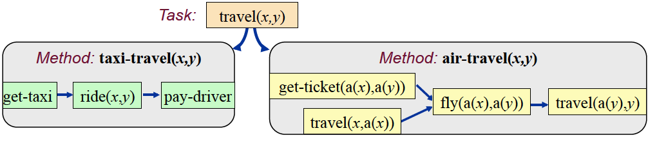
HTN Structure
Task represent recipes for achieving states.
Primitive tasks are grounded in literals.
Non-primitive tasks are further decomposed into subtasks subject to constraints.
Planning is searching through network for a consistent set of tasks to the goal from the initial state.

Slide 60
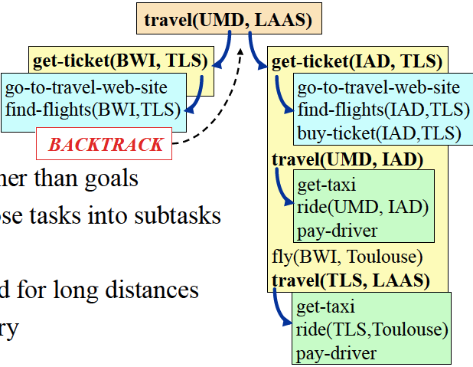
Example HTN Search

Slide 61
Real-World Use
HTNs are widely used in real-world applications.
Good at capturing domain information and limiting search to favored directed paths in the domain.
There are a number of domain-independent HTN planners, e.g., SIPE-2, SHOP-2, O-Plan, etc.

Slide 62
Case-Based Planning: Adapting old plans
Storing plans in a library and using them in “similar” situations.
How to index and retrieve existing plans?
How to adapt an old plan to solve a new problem?
Key question: will refitting existing plans save us work?

Slide 63
Contingent Planning
Develop plans that have built-in alternatives based on state-query during plan execution.
Usually have alternative branches only at points where it is expected to be significant.
Doesn’t guarantee that plan will execute successfully.

Slide 64
Uncertainty and contingencies
Flat-tire example: testing for hole will be part of the plan.
Information-gathering step has two outcomes! Previously, we assumed deterministic effects.
Why planning with information gathering (sensing) is hard?
Also need to deal with broken plans (assumptions, adversaries, unmodeled effects).

Slide 65
Conditional planning
Check(Tire1)
If Intact(Tire1) then Inflate(Tire1) else CallAAA
Separate sub-plans for each contingency.
Universal or Conformant plans: An extreme form of conditional planning that covers all possible execution-time contingencies.
Usually mean forcing environment into a state, e.g. two get two chairs the same color, paint both brown.
But, planning for many unlikely cases is expensive. Run-time re-planning is an alternative.

Slide 66
Re-Planning
Generate initial plan
Begin execution of the plan and monitor each step.
Check for inconsistencies between execution results and planning assumptions.
Replan when inconsistencies are detected.
What are dangers of replanning?

Slide 67
Multi-Agent Planning
Instead of centralized plan, now we have a coordinated plan based on individual agents committing to actions.
Agents have to negotiate with other agents to determine their actions.
Different negotiation environments, e.g., self-interested vs. cooperating.

